Slide 1
Emailing a Professor
Setting Up an Appointment
By Stacie Nomura

Slide 2
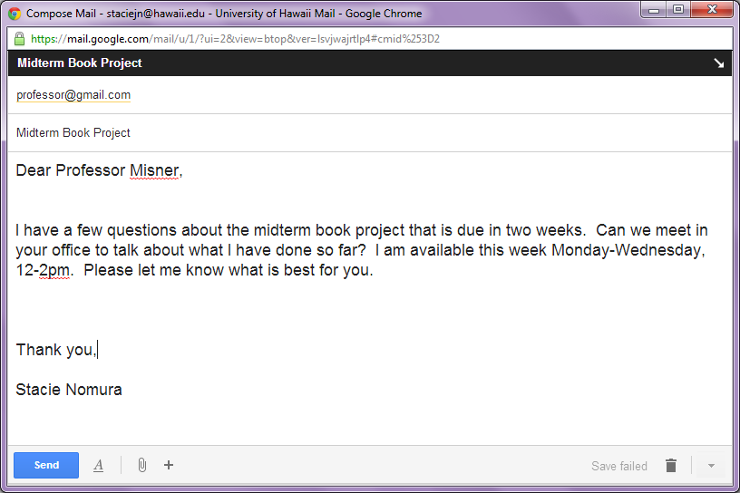
Three Main Parts

Slide 3
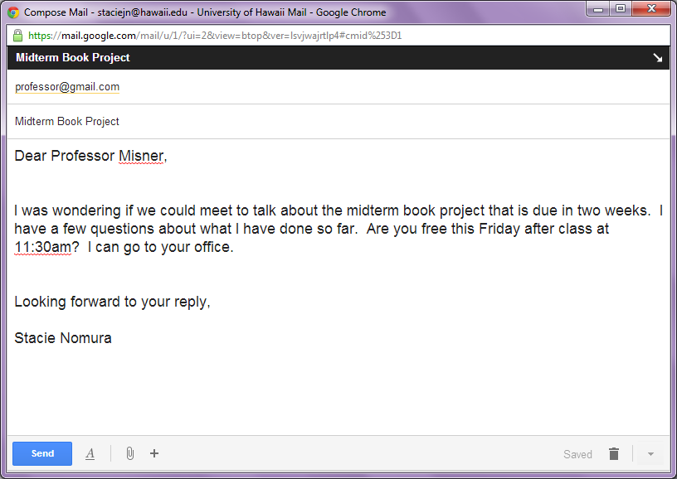
Different Ways to Say the Same Things
Email 1
Email 2

Slide 4
Different Ways to Say the Same Things
What
Can we meet to talk about…
I was wondering if we could meet to…
May I meet with you to…
When
I am available/free on/this/next…
Are you available/free on/this/next…
Would…be convenient?
When are you available/free?
Where
Can we meet at…
How about we meet at…
Where would you like to meet?

Slide 5
Answers
Greeting
Aloha
Dear
What
I was wondering if we could meet to talk…
May I meet with you to talk…
When
Are you free sometime before class on Friday?
I am free today (3/21) and tomorrow (3/22) from 9-1:30pm.
Where
Where is most convenient for me to meet you?
Shall I go to your office?
Closing
Sincerely
Thank you

Slide 6
Cloze Activity
Worksheet A
Worksheet B
Dear Professor Urabe
Could we meet in your office…
I am available on Friday…
Is this time convenient for you?
Thank you,
Dear Professor Urabe
I was wondering if we could meet in your office…
I am free
When is convenient for you?
Thank you,

Slide 7
