Slide 1
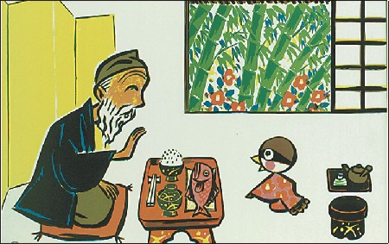
舌切り雀
Fable

Slide 2
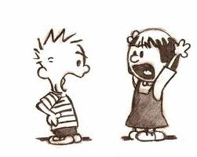
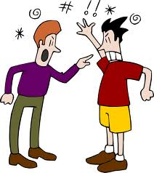
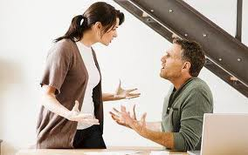
Argued
They argued about who should do the chores.
The brothers argued about who was taller and stronger.

Slide 3
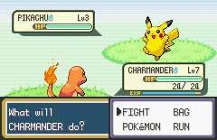
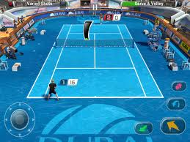
Challenged
Charmander challenged Pikachu to a fight.
I challenge you to a tennis match.

Slide 4
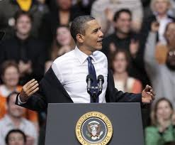
Remove
The model removed her coat while she walked.

Slide 5
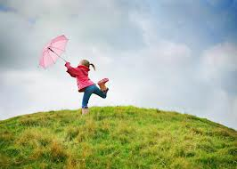
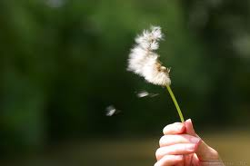
Blew
The wind blew the little girl’s umbrella away.
I blew on the flower, and its petals came off.

Slide 6
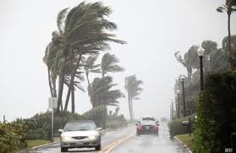
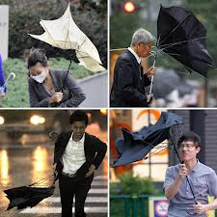
Gusts
Gusts of wind blew 100 kilometers per hour.

Slide 7
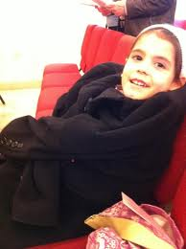
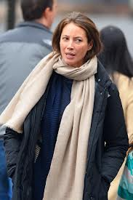
Wrapped
She is wrapped up in the jacket.
The scarf is wrapped around her neck.

Slide 8
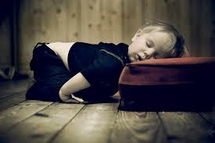
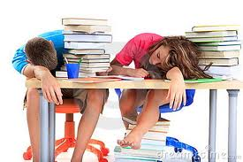
Exhausted
I was exhausted from studying all night.

Slide 9
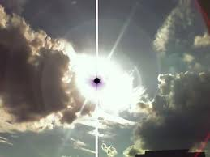
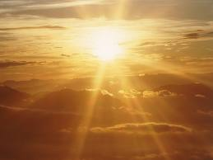
Shone
The sun shone from behind the moon.

Slide 10
Vocabulary Practice!

Slide 11
Worksheet #1 Answers
g - argued
b - challenged
h - remove
f - blew
a - gusts
c - wrapped
e - exhausted
d - shone

Slide 12
Worksheet #2 Answers
1. Who are the three main characters?
The sun, the wind, and the man
2. What is the man wearing?
A jacket
3. What did the wind do to the man?
Blew strong gusts of air at him
4. What did the sun do to the man?
Gently shone light on him
5. Who won the challenge?
The sun

Slide 13
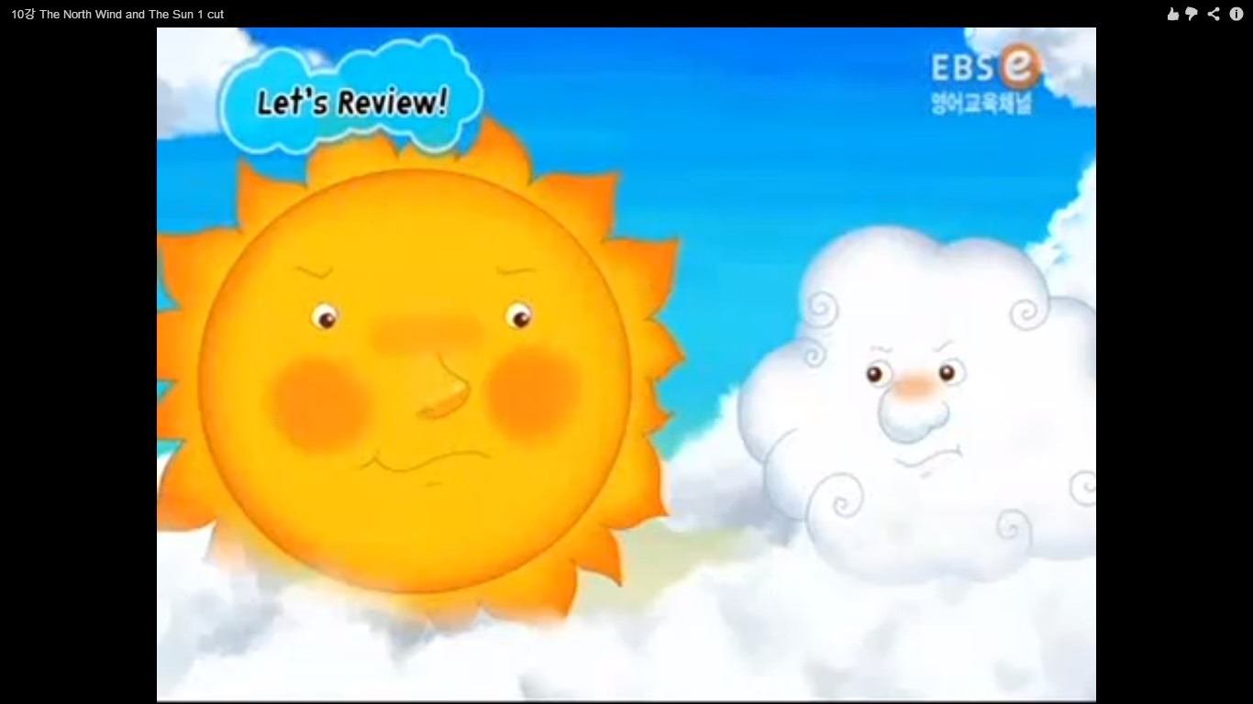
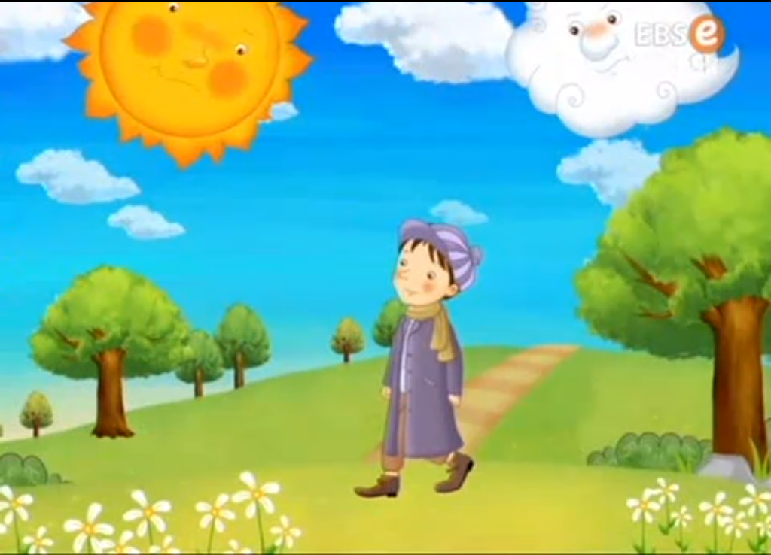
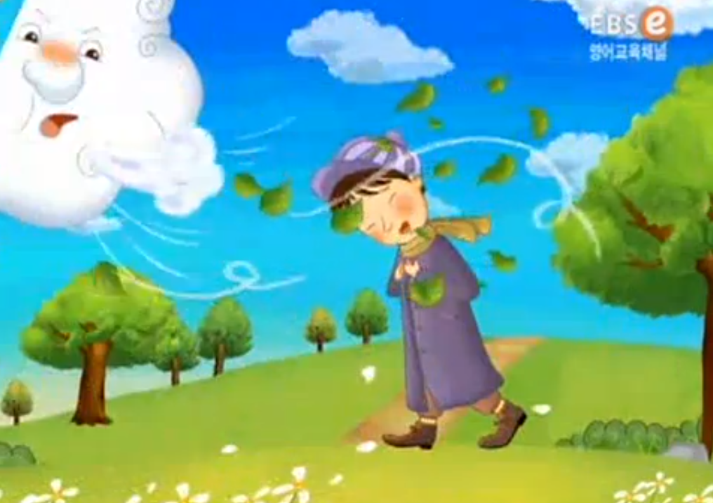
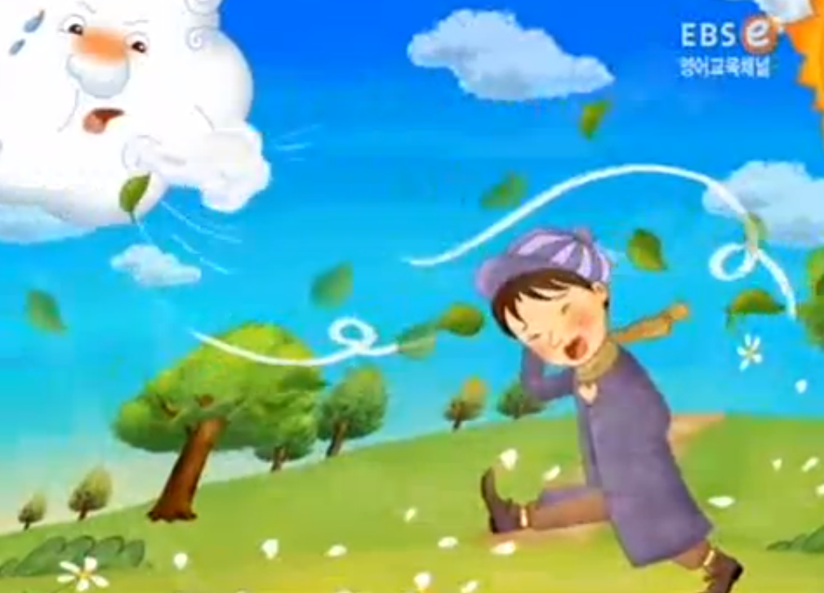
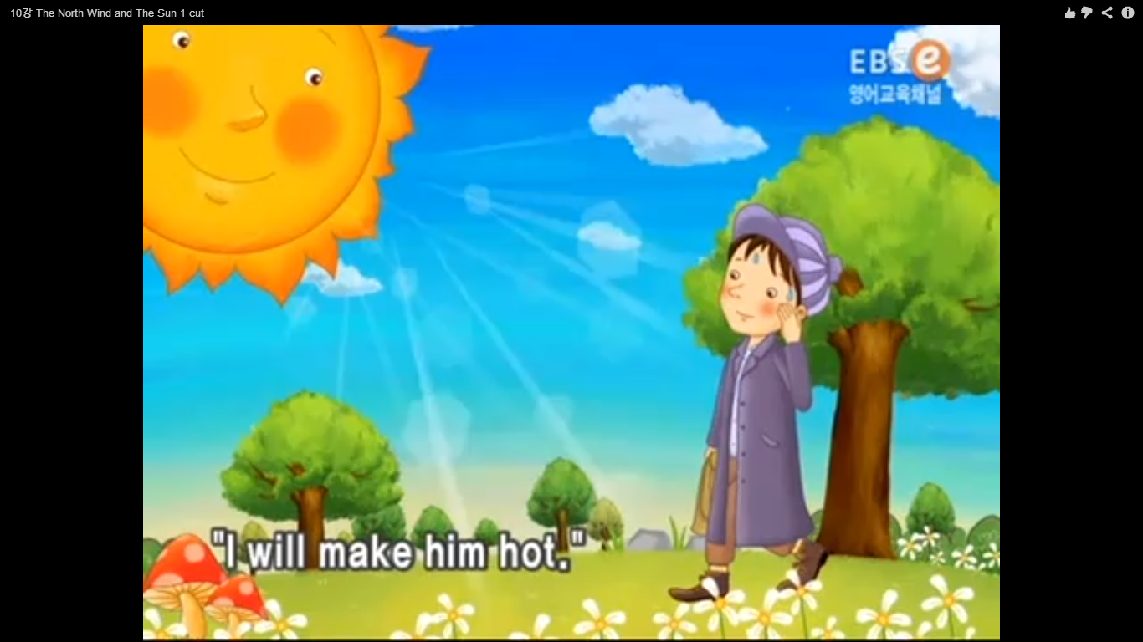
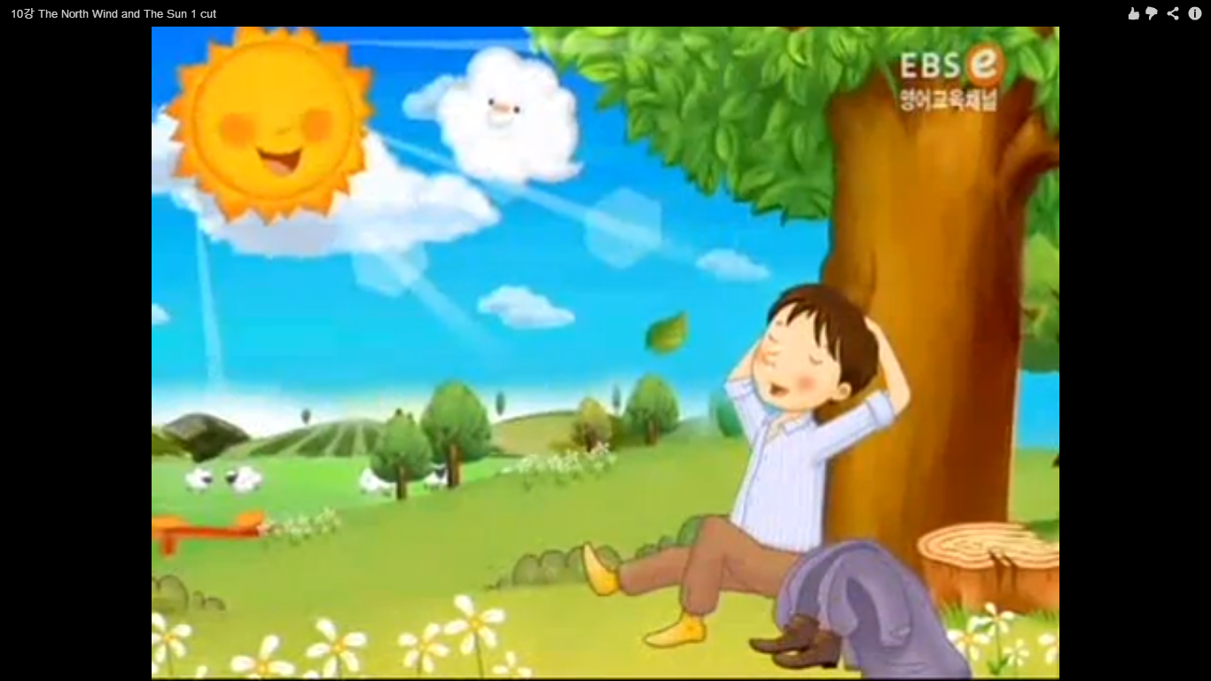
Put the Pictures in Order - Answers
1
3
5
2
4
6

Slide 14
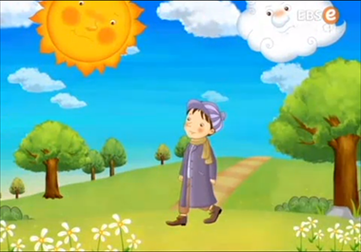
Match the Pictures with Text - Answers
1
2
3
1. The wind and the sun argued one day over which one was stronger.
2. Seeing a man walking on the road, they challenged each other to see which one could remove the jacket from the man the fastest.
3. The wind started. He blew gusts of air so strong that the man could not walk. But the man wrapped his jacket around him tightly.

Slide 15
Match the Pictures with Text - Answers
4
5
6
4. The wind blew harder and harder, and the harder the wind blew, the tighter the man wrapped his jacket around him. The wind blew until he was exhausted, but he could not remove the jacket from the man.
5. Next was the sun’s turn. He gently shone his light on the man.
6. The sun did very little, but quietly shone on the man until the man became so warm that he took off his jacket and sat under a tree to rest.

Slide 16
Worksheet #5 Answers
The wind blew gusts of air so strong that the man could not walk. But the man wrapped his jacket around him tightly. The wind blew harder and harder, and the harder the wind blew, the tighter the man wrapped his jacket around him. The wind blew until he was exhausted, but he ­­­­­couldn’t remove the jacket from the man. The sun gently shone his light on the man. The sun did very little, but quietly shone on the man until the man became so warm that he removed his jacket and sat under a tree to rest.

Slide 17
Gentle or Strong?
Situation 1: Asking the girl/guy you like to be your Valentine.
Situation 2: Getting your younger sibling to eat all of his/her vegetables.
Situation 3: Telling your friend to not ride his/her bike at night.
Situation 4: Telling your classmate to finish tonight’s homework.

